Slide 1
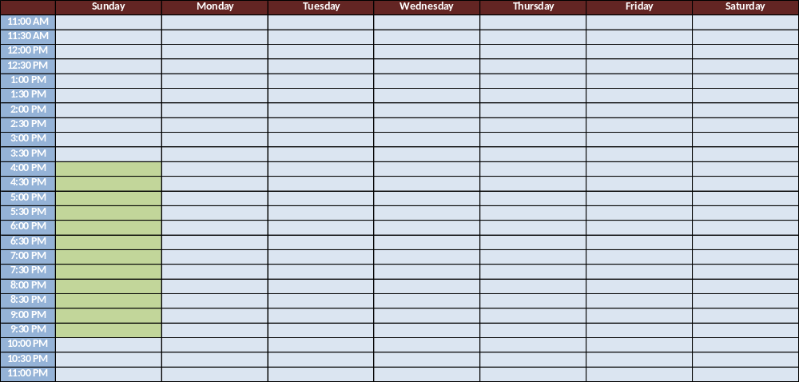
Creating 1st Event:
Step 1: Drag input field vertically over a set period of time (e.g. Sunday 4:00 PM – 10:PM)
Recurring Offer
Event Modifications
Restaurant Name

Slide 2
Creating 1st Event:
Step 2: Input field comes up where they can select the timeslots, recurrence days, Transparentt discount %, Opaque discount % and # of Seats available.
Recurring Offer
Event Modifications
Restaurant Name
Transparent

Rolling Period
End Date
Opaque

Create an Event
4:00 PM – 10:00 PM
Repeat at available 30 minute time slots :
4:00 4:30 5:00 5:30 6:00 6:30 7:00
7:30 8:00 8:30 9:00 9:30 10:00









Repeat on following days

Su M T W Th F Sa



Transparent Discount %:
30%
Opaque Discount %:
35%
# of Seats Available per half an hour time-slot:
10
Create Recurring Event

Slide 3
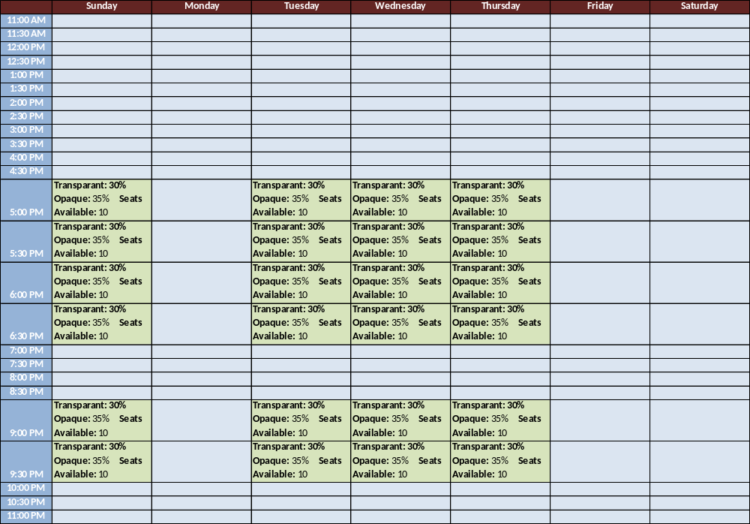
Creating 1st Event:
Step 1: Drag input field vertically over a set period of time (e.g. Sunday 4:00 PM – 10:PM)
Recurring Offer
Event Modifications
Restaurant Name
Transparent

Rolling Period
End Date
Opaque


